Slide 1
White Box vs. Black Box
Testing
Mohamed Ishraque

Slide 2
What is White Box testing
White box testing is testing where we use the info available from the code of the component to generate tests.
This info is usually used to achieve coverage in one way or another – e.g.
Code coverage
Path coverage
Decision coverage
Debugging will always be white-box testing

Slide 3
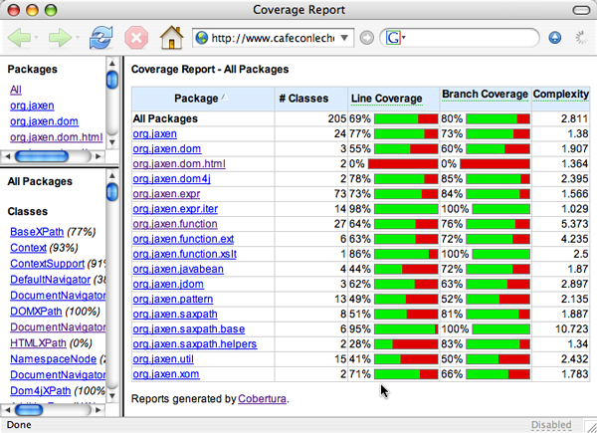
Coverage report. Example – 1

Slide 4
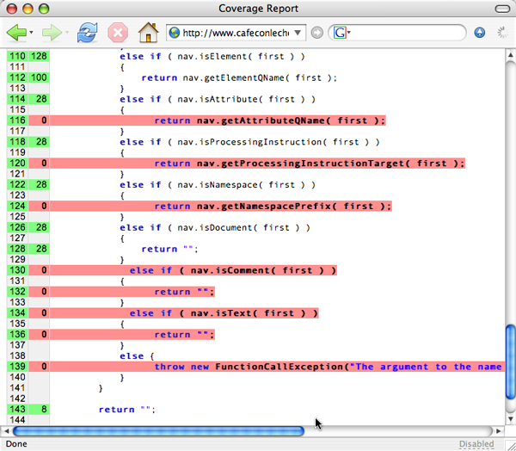
Coverage report. Example – 2

Slide 5
McCabe’s cyclomatic complexity
Mathematically, the cyclomatic complexity of a structured program is defined with reference to a directed graph containing the basic blocks of the program, with an edge between two basic blocks if control may pass from the first to the second (the control flow graph of the program). The complexity is then defined as:
  v(G) = E − N + 2P
  v(G) = cyclomatic complexity
  E = the number of edges of the graph
  N = the number of nodes of the graph
  P = the number of connected components

Slide 6
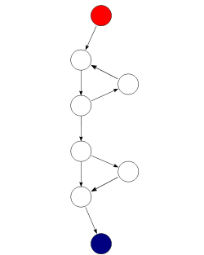
Graph example
We have eight nodes – N = 8 –
nine edges – E = 9 – and we have
only one component – P = 1.
Thus, we have
v(G) = 9 – 8 + 2 = 3.

Slide 7
Simple case - 1
S1;
IF P1 THEN S2 ELSE S3
S4;
One predicate – P1. v(G) = 2
Two test cases will cover all code
S1
P1
S2
S3
S4

Slide 8
Simple case – 2
S1;
IF P1 THEN X := a/c ELSE S3;
S4;
One predicate – P1. v(G) = 2
Two test cases will cover all paths
but not all cases. What about the
case c = 0?
S1
P1
a/c
S3
S4

Slide 9
Using v(G)
The minimum number of paths through the code is v(G).
As long as the code graph is a DAG – Directed Acyclic Graph – the maximum number of paths is 2**|{predicates}|
Thus, we have that
V(G) < number of paths < 2**|{predicates}|

Slide 10
Problem – the loop
S1;
DO
IF P1 THEN S2 ELSE S3;
S4
OD UNTIL P2
S5;
No DAG. v(G) = 3 and Max
is 4 but there is an “infinite”
number of paths.
S1
P1
S2
S3
S4
P2
S5

Slide 11
Nested decisions
S1;
IF P1 THEN S2 ELSE
S3;
IF P2 THEN S4 ELSE S5
FI
S6;
v(G) = 3, while Max = 4.
Three test case will cover all
paths.
S1
P1
S3
S2
S4
P2
S5
S6

Slide 12
Using a decision table – 1
A decision table is a general technique for full path coverage. It will, however, in many cases, lead to over-testing.
The idea is simple.
Make a table of all predicates.
Insert all combinations of True / False – 1 / 0 – for each predicate
Construct a test for each combination.

Slide 13
Using a decision table – 2
P1 | P2 | P3 | Test description or reference
0 | 0 | 0
0 | 0 | 1
0 | 1 | 0
0 | 1 | 1
1 | 0 | 0
1 | 0 | 1
1 | 1 | 0
1 | 1 | 1

Slide 14
Using a decision table – 3
Three things to remember: The approach as it is presented here will only work for
Situations where we have binary decisions.
Small chunks of code – e.g. class methods and small components. It will be too laborious for large chunks of code.
Code that is difficult to reach may not be necessary.

Slide 15
Decision table example
P1 | P2 | Test description or reference
0 | 0 | S1, S3, S5, S6
0 | 1 | S1, S3, S4, S6
1 | 0 | S1, S2. S6
1 | 1 | S1, S2. S6
S1
P1
S3
S2
S4
P2
S5
S6
The last test is not necessary

Slide 16
What about loops
Loops are the great problem in white box testing. It is common practice to test the system going through each loop
0 times – loop code never executed
1 time – loop code executed once
5 times – loop code executed several times
20 times – loop code executed “many” times

Slide 17
Error messages
Since we have access to the code we should
Identify all error conditions
Provoke each identified error condition
Check if the error is treated in a satisfactory manner – e.g. that the error message is clear, to the point and helpful for the intended users.

Slide 18
What is Black Box testing
Black box testing is also called functional testing. The main ideas are simple:
Define initial component state, input and expected output for the test.
Set the component in the required state.
Give the defined input
Observe the output and compare to the expected output.

Slide 19
Info for Black Box testing
That we do not have access to the code does not mean that one test is just as good as the other one. We should consider the following info:
Algorithm understanding
Parts of the solutions that are difficult to implement
Special – often seldom occurring – cases.

Slide 20
Clues from the algorithm
We should consider two pieces of info:
Difficult parts of the algorithm used
Borders between different types of solution – e.g. if P1 then use S1 else use S2. Here we need to consider if the predicate is
  Correct, i.e. contain the right variables
  Complete, i.e. contains all necessary conditions

Slide 21
Black Box vs. White Box testing
We can contrast the two methods as follows:
White Box testing
  Understanding the implemented code.
  Checking the implementation
  Debugging
Black Box testing
  Understanding the algorithm used.
  Checking the solution – functional testing

Slide 22
Testing real time systems
W-T. Tsai et al. have suggested a pattern based way of testing real time / embedded systems.
They have introduced eight patterns. Using these they have shown through experiments that, using these eight patterns, they identified on the average 95% of all defects. We will have a look at three of the patterns.
Together, these three patterns discovered 60% of all defects found

Slide 23
Basic scenario pattern - BSP
PreCondition == true / {Set activation time}
Check for
precondition
IsTimeout == true / [report fail]
Check
post-condition
PostCondition == true / [report success]

Slide 24
BSP – example
Requirement to be tested:
If the alarm is disarmed using the remote controller, then the driver and passenger doors are unlocked.
Precondition: the alarm is disarmed using the remote controller
Post-condition: the driver and passenger doors are unlocked

Slide 25
Key-event service pattern - KSP
KeyEventOccurred / [SetActivationTime]
Check
precondition
PreCondition == true
Check for key
event
Check
post-condition
IsTimeout == true / [report fail]
PostCondition == true / [report success]

Slide 26
KSP- example
Requirement to be tested:
When either of the doors are opened, if the ignition is turned on by car key, then the alarm horn beeps three times
Precondition: either of the doors are opened
Key-event: the ignition is turned on by car key
Post-condition: the alarm horn beeps three times

Slide 27
Timed key-event service pattern - TKSP
KeyEventOccurred / [SetActivationTime]
Check
precondition
PreCondition == true
DurationExpired /
[report not exercised]
Check for key
event
Check
post-condition
IsTimeout == true / [report fail]
PostCondition == true / [report success]

Slide 28
TKSP – example (1)
Requirement to be tested:
When driver and passenger doors remain unlocked, if within 0.5 seconds after the lock command is issued by remote controller or car key, then the alarm horn will beep once

Slide 29
TKSP – example (2)
Precondition: driver and passenger doors remain unlocked
Key-event: lock command is issued by remote controller or car key
Duration: 0.5 seconds
Post-condition: the alarm horn will beep once

